Slide 2
UI Design: Monday Week 3
Dr. Jillian Aurisano
Plan for today:
Announcements/Course logistics
Learning and discovering UI features
Notes:
So welcome to engineering visual interfaces for data science. I'm Dr Aurisano.
Thanks for finding the class on Zoom. Hopefully we will be in person again soon.
If anyone out there is comfortable turning on their cameras, that is lovely- then I feel like I am talking to students, rather than to myself.
Here’s our plan for today:
First I’m going to introduce myself, so you know a bit about me
Then we are going to get to know each other, in Zoom breakout rooms. This will give us a chance to make sure that Zoom breakout rooms work, and we all know how to access them.
Then, I am going to walk through the structure, and plan for the course. I want to make sure everyone knows how the course will work, and what to expect, and also a bit about why the course is designed this way.
Then I am going to introduce the class, and what the class is about. Since this is a new class, and one of just a few classes in human centered computing here at UC, I wanted to give an overview of the topic.
Then I have an introductory activity, which we will do in breakout rooms, and which I think will help motivate the discussion on Wednesday, and getting into the meat of the class.

Slide 3
Announcements / Course logistics
Homework 2- Questions?
Change- see announcement
Ask Discord if you encounter coding issues, installation problems, VS code questions. This is always faster than asking me!
Project 1- Questions?
Homework 3

Slide 4
Course recap
Our goal is to create Usable Interfaces
Usability -> Learnability, Efficiency, Safety
We need to center our designs on our user’s goals and needs
Which we capture through engagement with users
Sketching helps us implement lightweight versions of ideas, to test and get feedback before developing
There are coding languages (e.g., html, css, javascript) that enable us to translate visual elements into interactive websites.
Svelte is an example of a framework- which aims to better organize the development process

Slide 5
Usability
Learnability
How easy is the interface to learn?
Efficiency
How efficiently can users accomplish their tasks with the interface?
Safety/Errors
Are errors few and easy to recover from

Slide 6
How do you learn to use a new interface?
Discussion:
Think of a new interface you needed to use
An app, on a device, a webpage…
Talk to your neighbors about the experience- how do you remember learning this interface?
How did you approach this new UI?

Slide 7
Many cases users learn by doing
Users often don’t start using a UI with the goal of learning the UI
User’s typically try to do what they want to do, they have a goal in mind
They explore the interface to see if they can figure out how to do it.

Slide 8
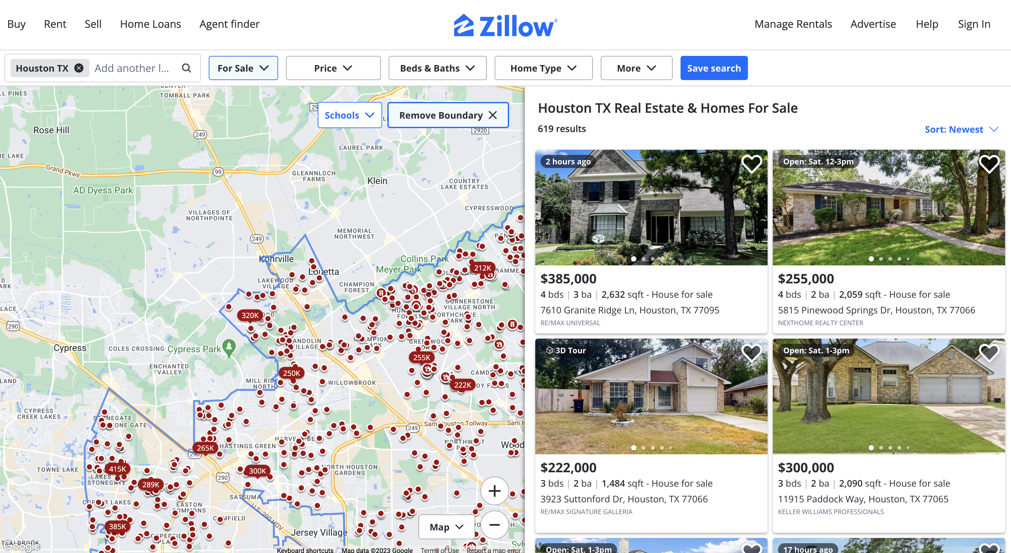
How do you learn to use a new interface?
Example- Zillow
Why is someone going to Zillow?
Would you watch a tutorial or read a help manual?

Slide 9
In general, users are not there to learn your UI
Users are more interested in achieving their goal than in learning your interface
As a UI designer your job is to clearly communicate how to use the UI, through the design, and help the user achieve their first goal
User expectation: getting things done, not learning the interface

Slide 10
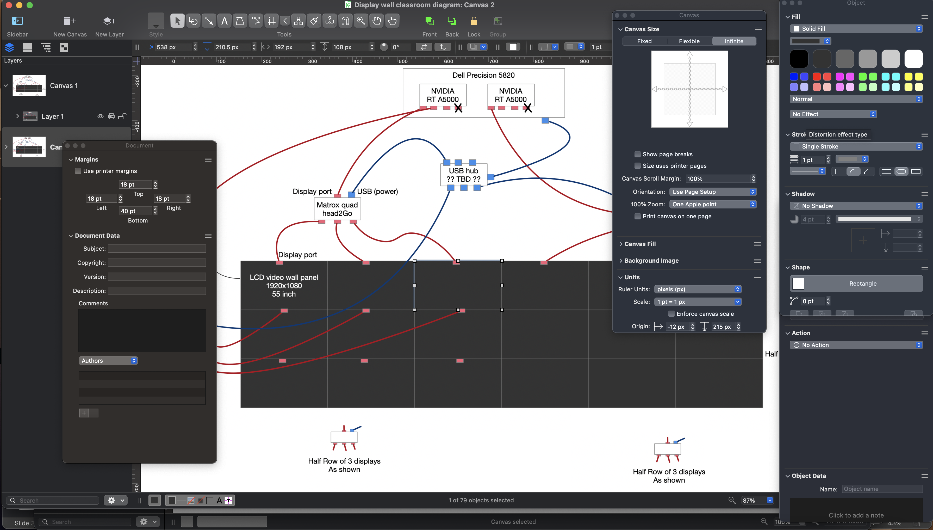
What about this?
Example- Omnigraffle, vector graphics software
Consider also Adobe software
Are you open to watching a tutorial to learn this?

Slide 11
What makes these different?

Slide 12
Learn by doing
Casual users
Tasks not for work
The task is not too complex
Find houses that fit my criteria
Browse them
Have other options if your UI is not working for them

Slide 13
Might learn through a manual
Complex tasks
Need lots of features to design a graphic to your specifications
Professional users
Willing to invest time to learn these features

Slide 14
Let’s complicate this simple picture
Do you think there are users of applications like Zillow who are
Professionals
Trying to accomplish complex tasks, and need additional features
Willing to invest time watching a tutorial, reading a handbook?

Slide 15
Let’s complicate this simple picture
Do you think there are users of applications like Omnigraffle who are
Not serious professionals
Just want to get started with a simple diagram

Slide 16
Diversity of users might require a couple of learning approaches
A way for casual users to get started right away accomplishing straightforward tasks
A way for serious users to learn advanced features
Often need to consider both

Slide 17
What if learning by doing doesn’t work?
Anyone have an example of not being able to learn an interface by trying to accomplish a task?

Slide 18
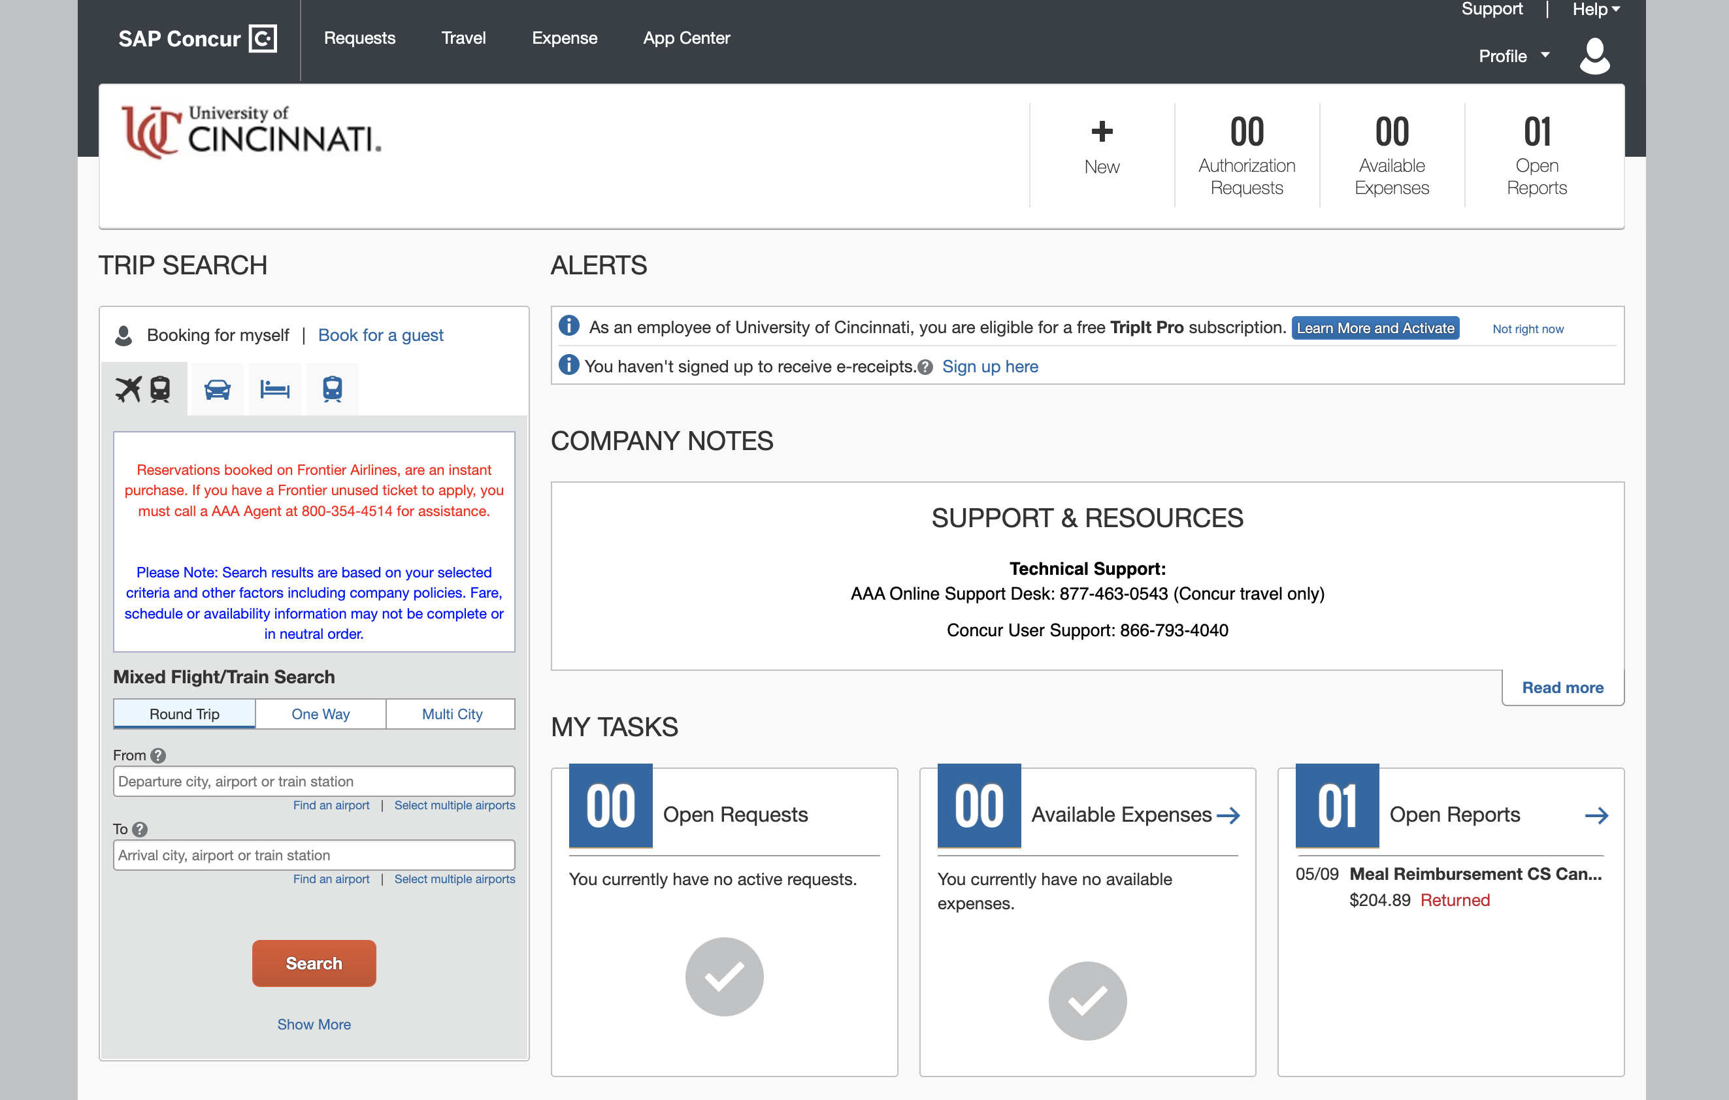
My example of wanting to learn by doing, but can’t
Travel booking through UC

Slide 19
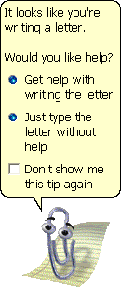
Learn by seeking help?
Users resort to seeking help when they get stuck
User is trying to accomplish a task
They have a problem and are looking for a solution
Last resort options:
Chatbots to help
Help buttons
Search
Giving these help options is good, but not enough

Slide 20
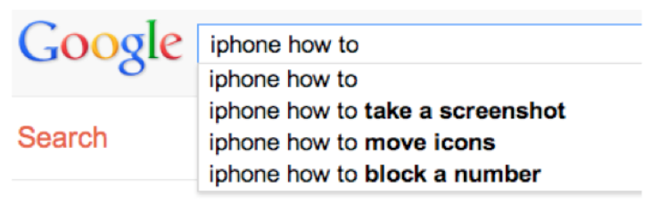
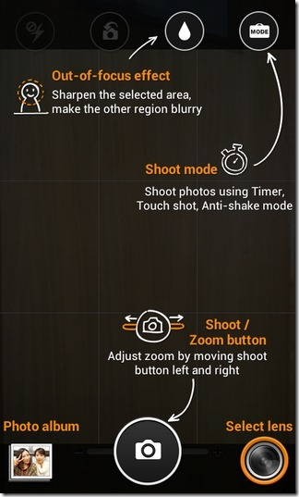
Learn by seeking help?
If you are going to provide help options, there are ways to do it well
Searchable help topics
Overlays on the interface
But still- not the ultimate goal

Slide 21
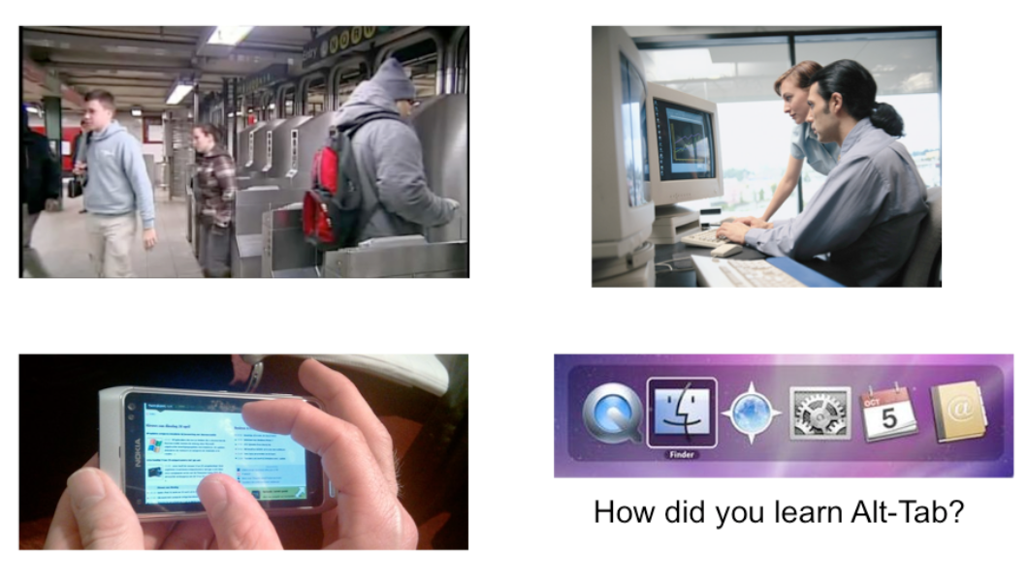
Learn by watching others?
You watch someone use something
Ok for some circumstances
Some professional UIs

Slide 22
Lessons for UI Designers
We want to match the design to the user’s goals
So, we need to:
Know who the users are
Know the users’ goals when you design
Process for collecting this information -> user centered design process

Slide 23
So
We discover how to operate something by perceiving its action possibilities (affordances)
We learn by doing- trying to accomplish our goals
We can promote learning by doing through
Feedback
Consistency

